Slide 1
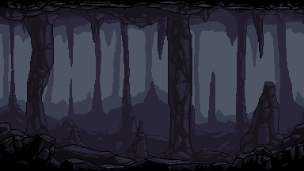
Dungeon Destroyer
Husain Patanwala - CS 210

Slide 2
General Overview
Turn-based RPG style combat game
Language: 100% Python
Pygame-ce library for game structure/ functionality
Goals:
Implement 3-4 levels with 1 boss level
Include various animations for entities
Create interactivity with upgrades and actions
Properly implement necessary DS’s

Slide 3
Data Structures and Algos
Algorithms
linear traversal
BFS & list reversal
Lists
store animation frames
dictionary values
Stacks/Queues
item upgrades
turn based combat
Dictionary
store animation lists
edges & coordinates
player progress
game settings
Graph
adjacency list
stores level edges
Tree
skill tree progression

Slide 4
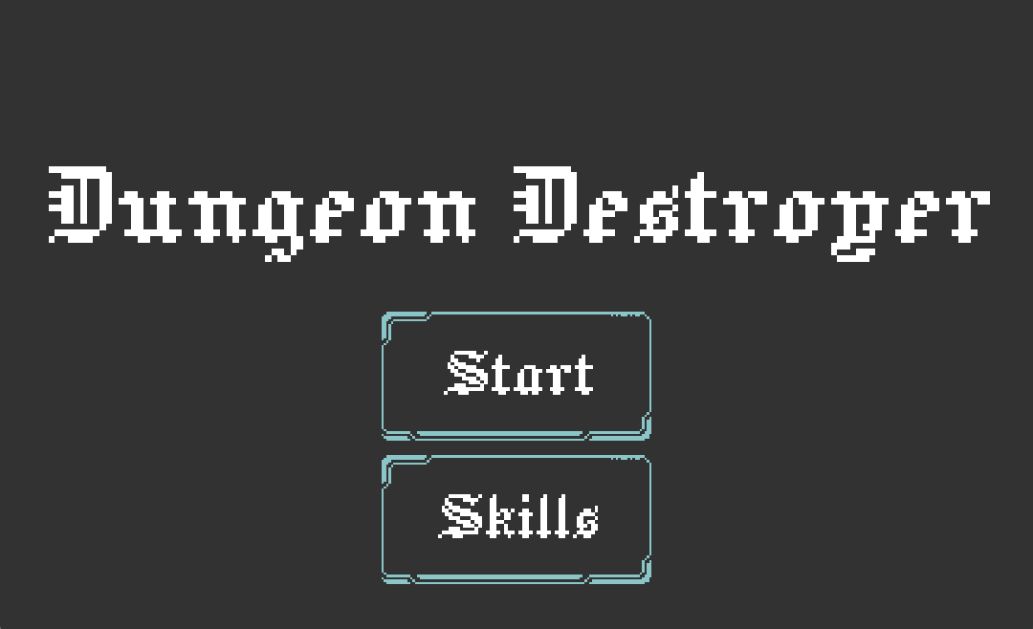
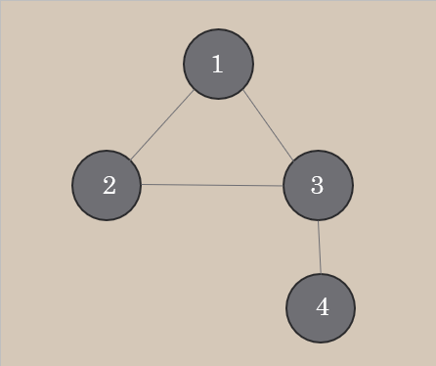
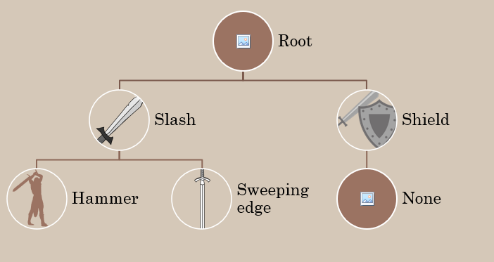
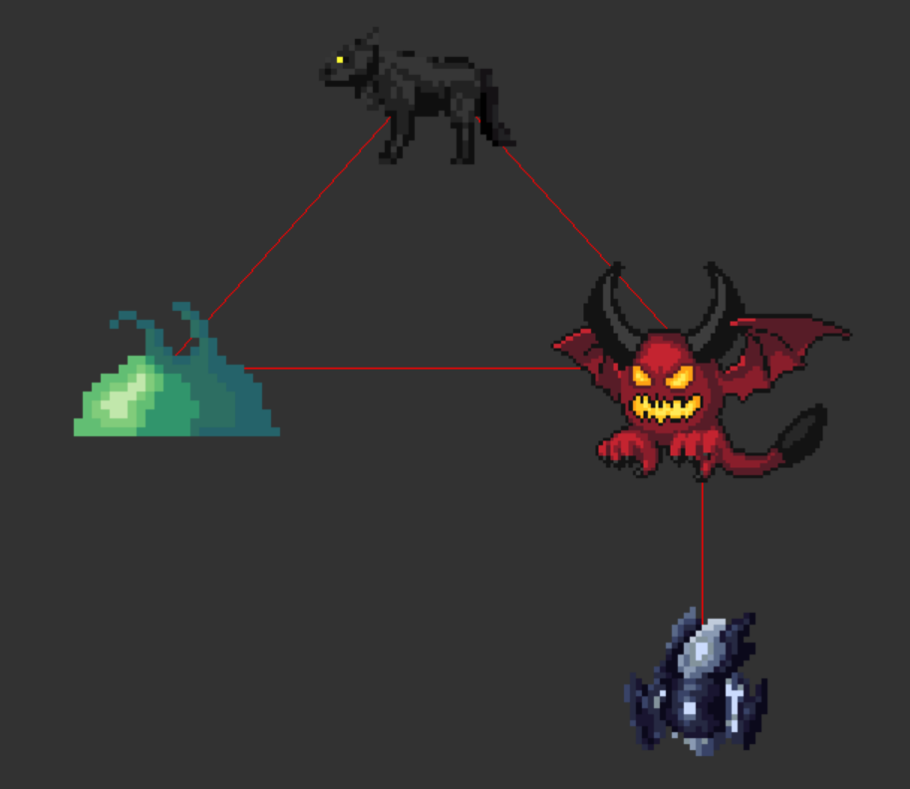
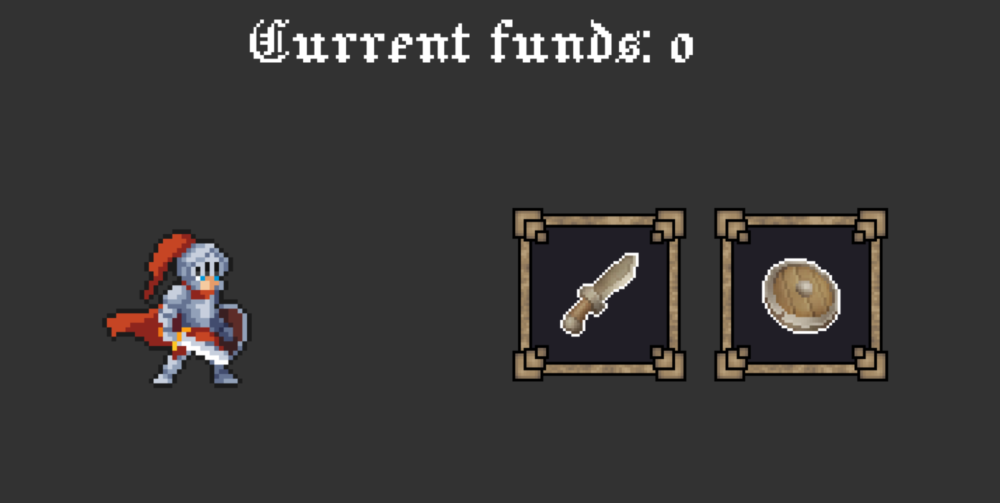
Mockup VS Implementation

Slide 5
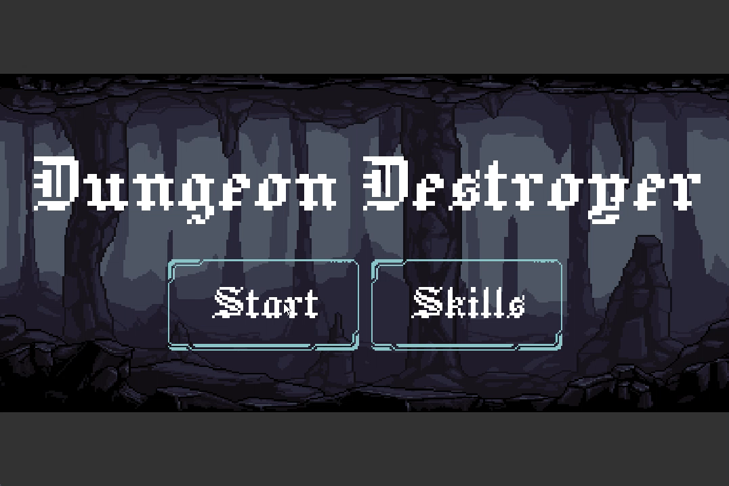
Code Implementation

